Slide 1
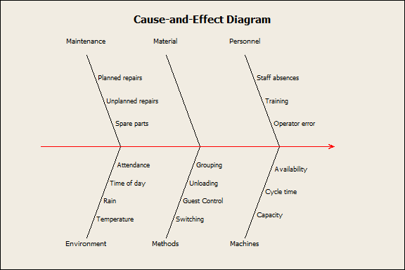
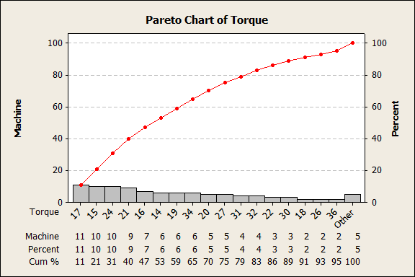
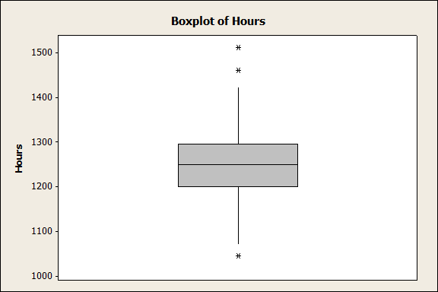
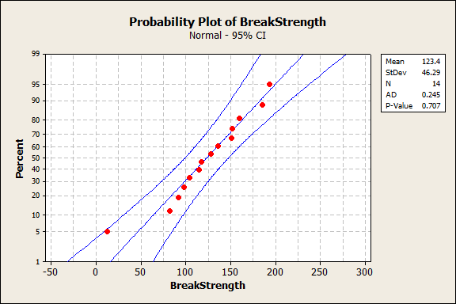
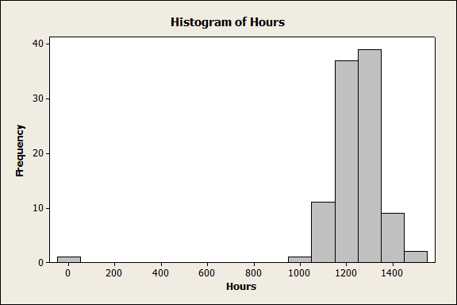
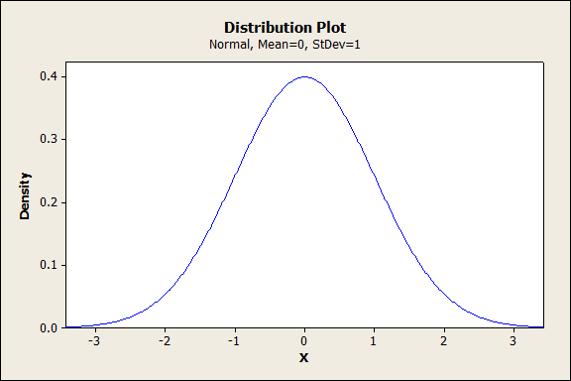
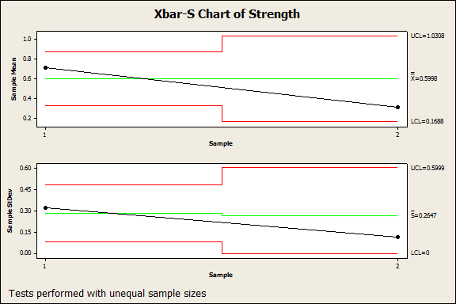
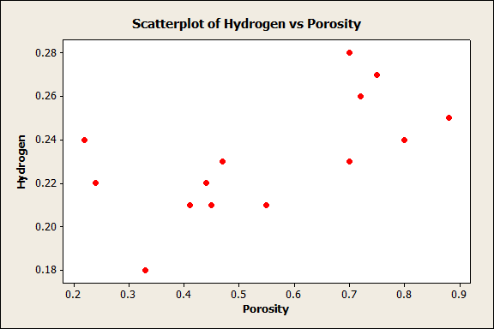
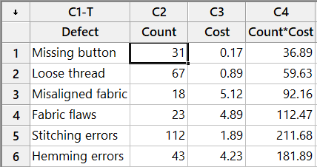
Exploratory Data Analysis Using Minitab
Rumana Jahan
IPE:01
ID:201636031
Cause and Effect diagram
Pareto Chart
Boxplot
Probability Plot of Breakstrength
Histogram
Bubble plot
Control Chart
Interval Plot
Distribution plot
MINITAB has many advantages for statistics, for example it save time when we are interested in making basic descriptive statistics for a large size sample, conducting hypotheses testing, writing a statistical report and scanning given data. For These data analysis
I have to use the following fuctions in MINITAB:
Stat -use this menu to analyse data. This key menu performs many useful statistical functions
Regression submenu: MINITAB has a Regression submenu in Stat to perform the analyses.
Graph -use this menu to graphically represent the data.
Editor -use this menu to edit and format thedata.
Help - this opens a standard Microsoft Help window containing information on how to use the many features of Minitab.
Some Other features are quality tools, control chart etc. submenu under stat menu .
To end a Minitab windows session choose File followed by Exit.
Control chart
Scatterplot

